Slide 1
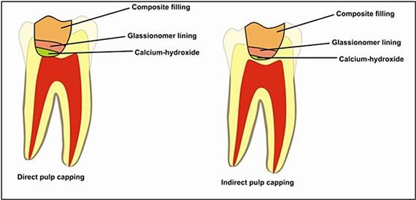
VITAL PULP THERAPY
Dr. Manuja Nair

Slide 2

What will u learn today??
1. Dentin-pulp Organ 2. Direct Pulp Capping 3. Indirect Pulp Capping 4. Pulpotomy

Slide 3
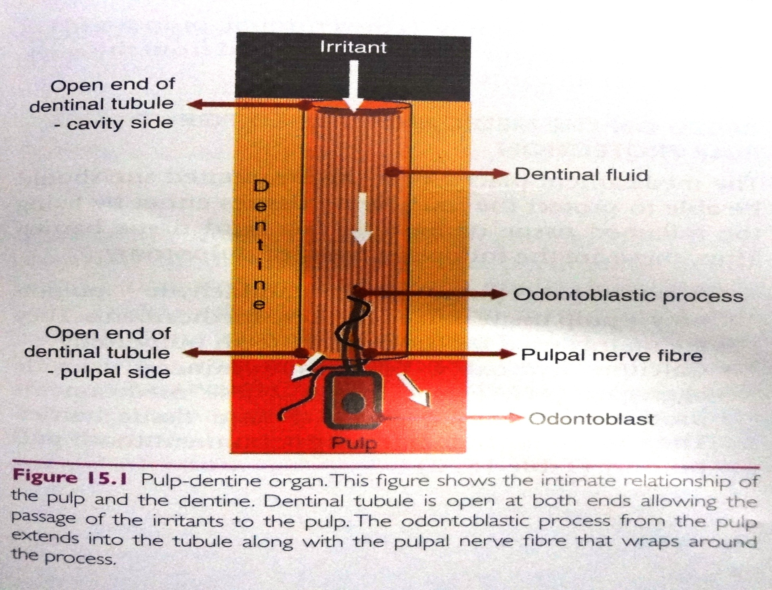

Slide 4
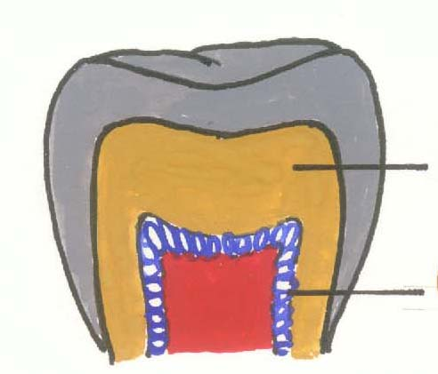
ODONTOBLAST SECRETORY ACTIVITY
PRIMARY DENTIN
ODONTOBLASTS

Slide 5
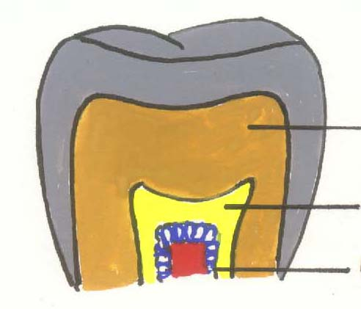
ODONTOBLAST SECRETORY ACTIVITY
PRIMARY DENTIN
PHYSIOLOGICAL SECONDARY DENTIN
ODONTOBLASTS

Slide 6
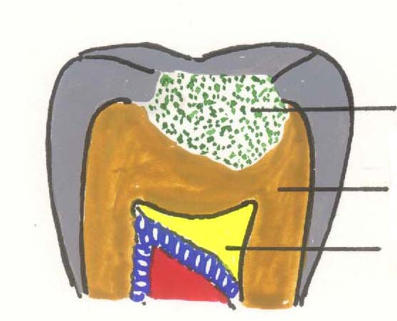
ODONTOBLAST SECRETORY ACTIVITY
INJURY
PRIMARY DENTIN
TERTIARY DENTIN

Slide 7

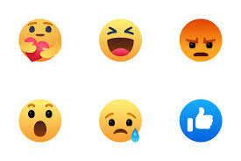
Tertiary Dentin
Tertiary dentin
Reparative Reactive

Slide 8
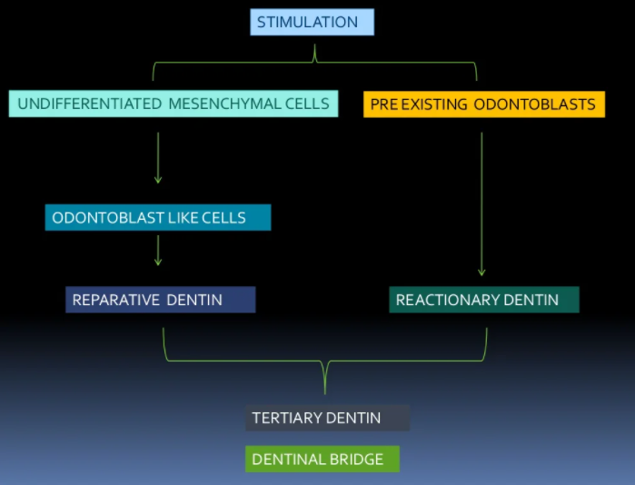

Slide 9
WHAT IS VITAL PULP THERAPY ?
To repair & maintain vitality pulp.
Removal of local irritant
Placement of protective material directly or indirectly over pulp.

Slide 10
DEFINITION
“Treatment initiated to preserve & maintain pulp tissue in a healthy state, tissue that has been compromised by caries, trauma or restorative procedures”…. INGLE 6th edi

Slide 11
OBJECTIVE
Stimulate formation of reparative dentin to retain the tooth as functional unit.

Slide 12
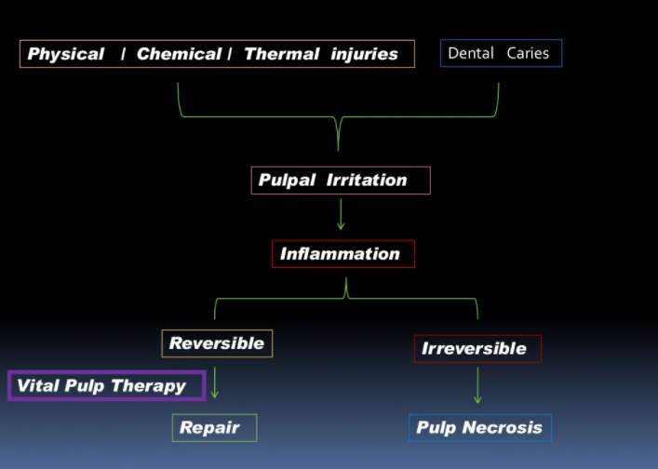

Slide 13
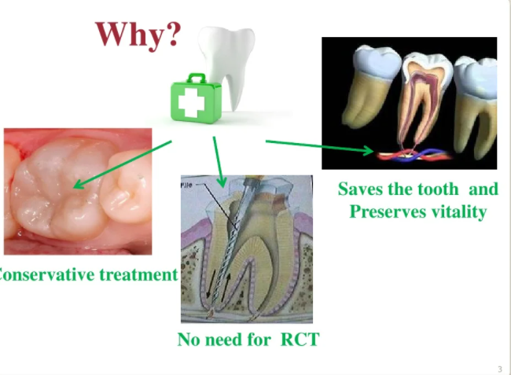

Slide 14

Indirect Pulp Capping:
Def
Rationale
Case selection
Caries excavation
Difference between infected & affected dentin
Procedure

Slide 15
INDIRECT PULP CAPPING
“Indirect pulp capping is defined as a procedure wherein the deepest layer of the remaining affected carious dentin is covered with a layer of biocompatible material in order to prevent pulpal exposure and further trauma to pulp.”

Slide 16
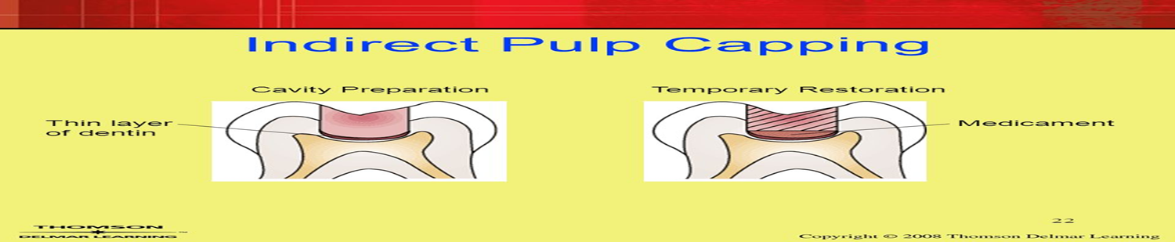

Slide 17
OBJECTIVE
Preserve vitality of the pulp
Stimulating the underlying odontoblasts to form tertiary dentin.

Slide 18
RATIONALE
Demineralization precedes bacterial invasion
Asymptomatic till bacteria within 0.5 mm from pulp
Softened dentin close to pulp – no bacteria
Absence of substrate kills or inactivates the few left behind
Therapeutic pulp capping agents may aid in dentin-bridge formation

Slide 19
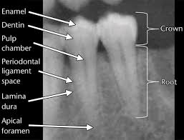

Slide 20
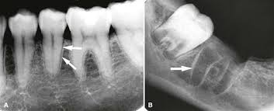
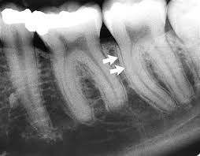
Lamina dura

Slide 21
INDICATIONS
HISTORY:
Mild discomfort: chemical & thermal stimuli.
Ab Spontaneous pain
CLINICAL EXAMINATION:
large carious exposure
Ab of lymphadenopathy
Normal gingiva & color of tooth
RADIOGRAPHIC EXAMINATION:
Large carious lesion; proximity to pulp
Normal lamina dura
Normal pdl
No periapical radiolucency

Slide 22
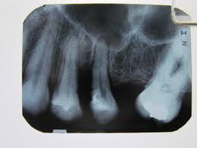
CONTRAINDICATIONS
HISTORY:
Lingering Pain
Spontaneous pain (night)
CLINICAL:
Excessive tooth mobility
Discoloration
No response to pulp test
RADIOGRAPHIC:
Large carious lesion with pulp exposure
Broken lamina dura
Widened PDL
Periapaical radiolucency
PDL widening

Slide 23
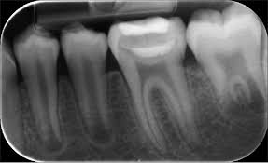
CLINICAL PROCEDURE
Single or two-step approach.
FIRST APPOINTMENT:
L.A & isolate with rubber dam.
Outline form

Slide 24
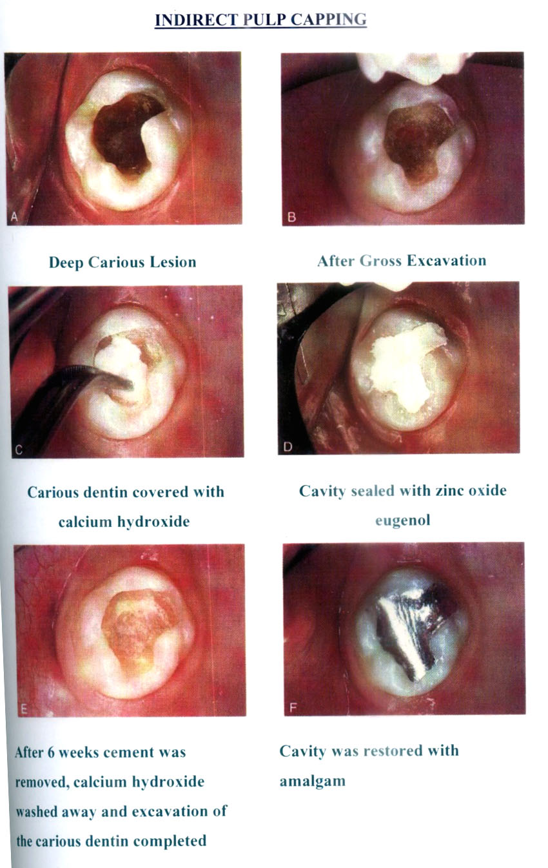

Slide 26
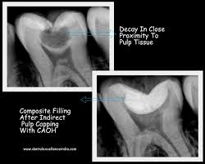
This sealed cavity is not disturbed for 6-8 weeks.

Slide 27
SECOND APPOINTMENT

Slide 28
Single/ one appt tech
Re-entry & excavation????
Risk of exposure

Slide 29
Caries excavation
a) Mechanical
Rotary: High and low speed
Non rotary – spoon excavators
Air abrasion
Ultrasonics
Slow speed drills preferable to the spoon excavators
b) Chemomechanical – carisolv
c) Photoablation – laser

Slide 30
Infected dentin | Affected dentin
Softened demineralized dentin with bacteria Collagen is irreversibly denatured Cannot remineralize Soft necrotic tissue, dry leathery dentin flakes Dyes: 1% Acid red in propylene glycol stains only irreversibly denatured collagen | Softened demineralized dentin not yet invaded by bacteria Collagen cross linking remains Template for remineralization Softer than normal dentin, discoloured , does not flake Does not stain

Slide 31
Choice of pulp capping agent:
a. Biocompatible
b. Provide biological seal
c. Prevent bacterial microleakage
Traditional – Ca (OH)₂ & ZnOE
Other materials tried – Dentin Adhesives, Glass ionomers, M.T.A, BMP( bone morphogenic proteins), Biodentin

Slide 32
Zinc Oxide Eugenol:
Obtundant & more comfortable
Interferes with polymerization of resins
Used only when R.D.T > 0.6 mm
Ca (OH)_{2:}
Induces reparative dentin formation
Does not interfere with resin polymerization
Used when RDT< 0.6 mm

Slide 33
Disadvantages
Dissolution →recurrent carries
Degrade upon tooth flexure
Tunnel defects→Dentin bridges →microleakage
Persistent stimulatory effect → Calcification
Does not adhere to composite resin or amalgam

Slide 34
Indirect pulp capping
Conventional
Ca (OH)₂ or ZOE
- Time tested
- Considerable degree of success
- Long term studies available
- Certain limitations
Dentin Bonding Agent
- Initial encouraging result
- Dispute over long term seal
- Conflicting reports on risk of cytotoxicity

Slide 35
Glass Ionomer Cement:
RMGIC – For both indirect and direct pulp capping
Histological response of pulp in both situations was similar to Ca (OH)2
Anti bacterial property
Ionic bonding – prevents microleakage
Remineralization

Slide 36
TREATMENT OUTCOME
Remaining dentin thickness
Choice of indirect pulp capping agent
Not recommended as predictable t/t for permanent teeth
Difficult to determine excavation halt???

Slide 37
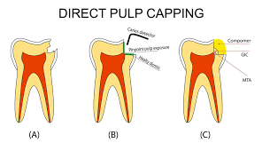
DIRECT PULP CAPPING

Slide 38
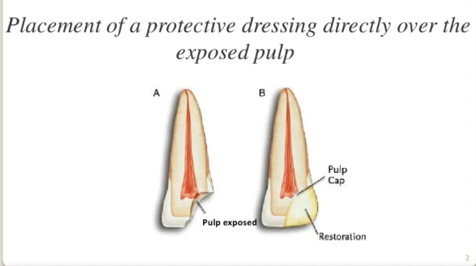

Slide 39
DIRECT PULP CAPPING
Its defined as the procedure in which the exposed vital pulp is covered with a protective dressing or base placed directly over the site of exposure in an attempt to preserve the pulpal vitality.

Slide 40
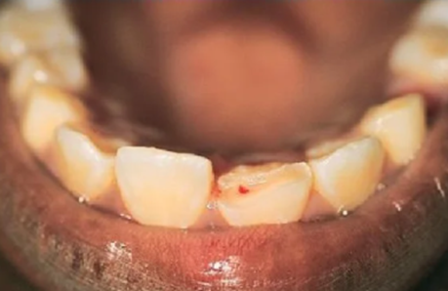
INDICATIONS
Iatrogenic mechanical exposure of pulp in an asymptomatic vital tooth with sound dentin at the periphery
Small carious exposures in an asymptomatic permanent tooth with an incomplete root formation.
Radiographically there should be no thickening of PDL space and no evidence of periradicular lesion.

Slide 41
CONTRAINDICATIONS
Large carious exposures in symptomatic permanent tooth
Spontaneous & nocturnal toothaches
Tooth mobility
Thickening of pdl
Periapical/ furcation R/L
Uncontrolled hemorrhage
Purulent exudate

Slide 42
Factors determining success of direct pulp capping
Size of exposure:
Hemorrhage
Location of exposure
Isolation

Slide 43
Initial Steps:
Control of hemorrhage and pre-treatment
Control Bleeding:
Haemostatic agents
Pressure application
Sodium hypochlorite pre-treatment : 2.5%
Controls hemorrhage
Provides disinfection
Removes dentin chips from subjacent pulp tissue
Removes fibrin and clot (chemical amputation)

Slide 44

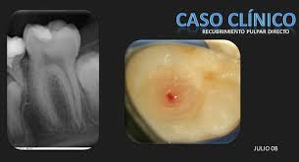
Pretreatment:
Chlorhexidine
Steroid antibiotic paste: Symptomatic tooth for 3-4 days prior to capping
Pin point exposure

Slide 45
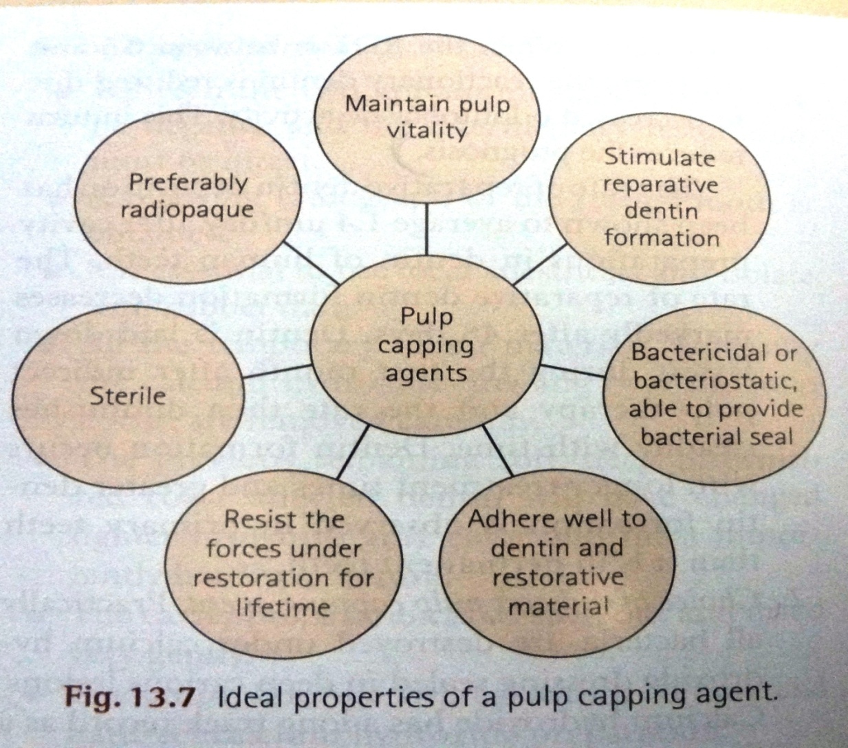
PULP CAPPING AGENTS AND THEIR TREATMENT PROTOCOLS

Slide 46
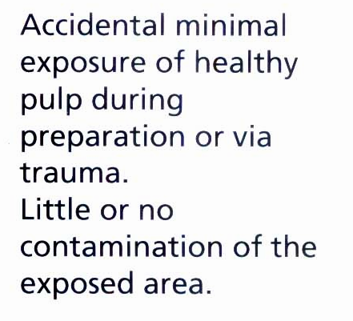
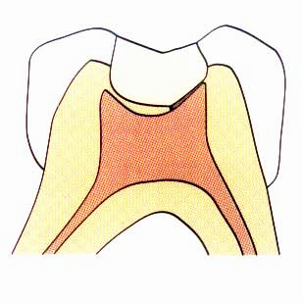

Slide 47
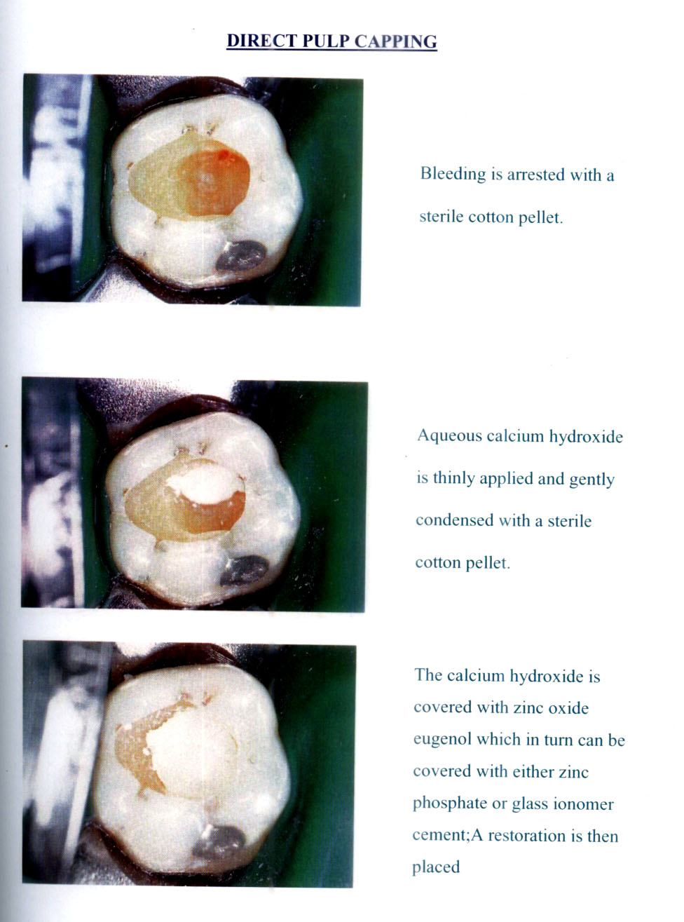

Slide 50
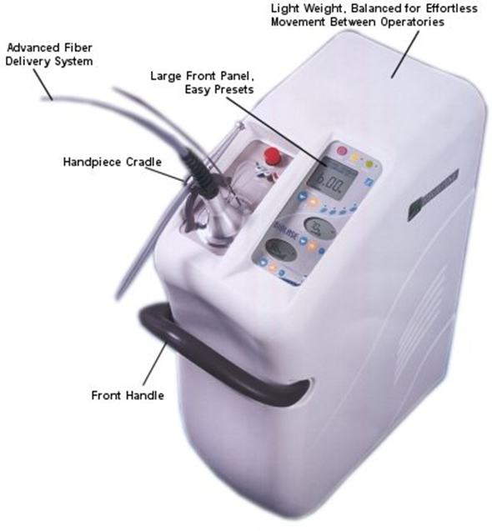
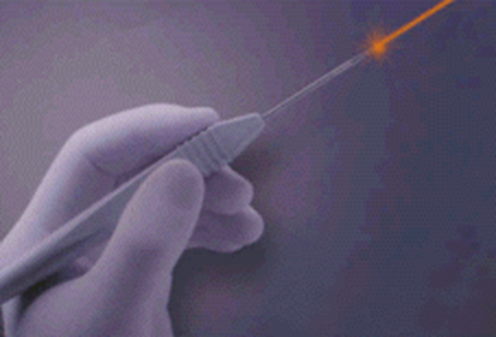
Laser treatment
Sterilizes exposed pulp and surrounding dentin
Scar formation owing to thermal effect
Both above – preserve pulp from bacterial invasion and help efficiently control hemorrhage
Direct stimulation of dentinogenesis.

Slide 51
Calcium Hydroxide
Non-setting type Setting type
(pH 11-13)High pH Low pH(pH 9-10)
Chemical cure/Light cure

Slide 52
Why Low pH preferable ???
Zone of obliteration → Zone of coagulation necrosis(Mummification)
Dentin bridge forms below the necrotic zone and pulp void is formed when necrotic zone resorbs subsequently.
Zone of obliteration but no zone of mummification
Dentin bridge formed
Subjacent to capped material
As necrotic zone resorbs prior to the formation of dentin bridge.
High pH Material
Low pH material

Slide 53
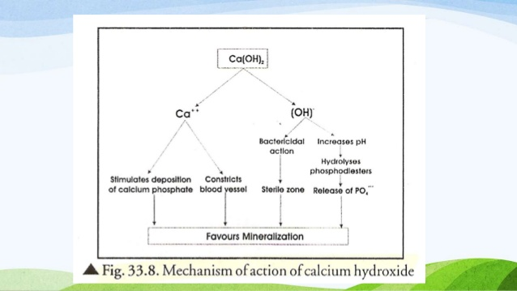

Slide 54
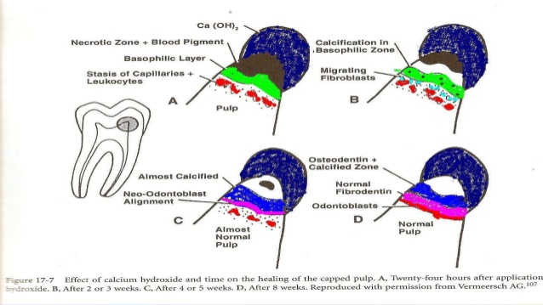

Slide 55
Mineral Trioxide Aggregate
Composition:
Tricalcium silicate,
tricalcium aluminate,
tricalcium oxide & certain mineral oxides
Advantages:
Highly biocompatible
Hydrophillic
Alkaline (pH 12) induce dentinogenesis

Slide 56
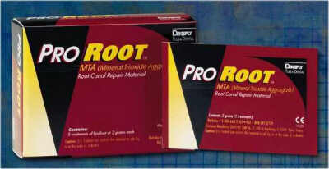
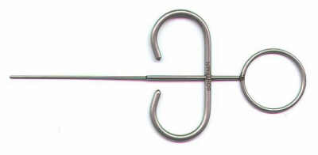

Slide 57
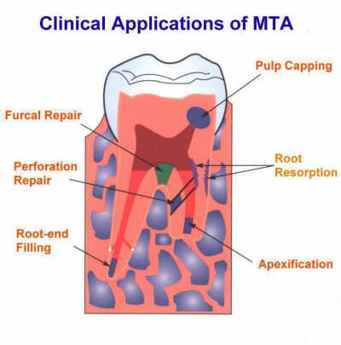

Slide 58
Collagen
Advantages:
induces dentinogenesis without pulpal necrosis
Disadvantages: Antigenicity of collagen is high.

Slide 59
Hydroxyapatite
Most stable, synthetic calcium phosphate ceramic.
Advantages:
Hydroxyapatite layer used as scaffolding for newly forming mineralized tissue.
healing is more desirable than that of Ca(OH)2

Slide 60
Antioxidants (Catalase)
Essential enzymes necessary for proper functioning of body’s defense mechanism
act as free radical scavengers and aid in healing process.

Slide 61
Growth factors in pulp capping
Physiologic approach
Family transforming growth factor.
T.G.F.Beta
B.M.P (Bone Morphogenic Protein)
T.G.F.Beta & B.M.P: Large signaling molecules that control differentiation of cell types.
regulates pulp cell differentiation

Slide 62
BONE MORPHOGENIC PROTEINS (B.M.P)
Limits inflammatory response
Accelerates Regeneration
Bio active material decreases risk of pulpal necrosis
Avoids excessive calcification ; dose dependent dentin deposition.
Dentin Bridge physiological quality

Slide 63
PULP CAPPING AGENTS
Calcium hydroxide
ZnOE
GIC
Dental Adhesives
MTA
Collagen
Antioxidants
Hydroxyapatite
Growth Factors: BMP

Slide 64
Recent Advances

Slide 65
Biodentine( BIOACTIVE)
Composition: tricalcium silicate, dicalcium silicate, calcium carbonate, zirconium oxide and iron oxide.
Mineralization→ release of TGF- β1 from pulpal cells to encourage pulp healing→ osteodentine →reparative dentine.
ADVANTAGES:
better handling characteristics,
reduced setting time

Slide 66
PULPOTOMY
Its defined as a procedure in which a portion of exposed vital pulp is surgically removed as a means of preserving the vitality and function of the remaining radicular portion. The procedure is similar in concept to direct pulp capping except in the amount and extent of pulp tissue removal.

Slide 67
OBJECTIVES
Preservation of vitality of radicular pulp
Relief of pain in patients with acute pulpalgia and inflammatory changes in the tissue
Ensuring the continuation of normal apexogenesis in immature permanent teeth by retaining the vitality of pulp

Slide 68
INDICATIONS
Mechanical or carious exposures in permanent teeth with incomplete root formation.
Traumatic exposures of longer duration where coronal pulp is inflamed in young permanent teeth.
Pulpally involved children’s permanent teeth in which the root apex is not completely formed
Carious pulp exposure in an asymptomatic primary tooth for eg., a child’s posterior tooth with wide open apices that has a small, asymptomatic carious exposure.

Slide 69
CONTRAINDICATIONS
Patients with irreversible pulpitis
Abnormal sensitivity to heat and cold
Chronic pulpalgia
Tenderness to percussion or palpation because of pulpal disease
Periradicular radiographic changes
Marked constriction of pulp chamber or root canals [calcifications]

Slide 70
CLASSIFICATION
Amount of pulpal tissue involved
Cervical pulpotomy
Partial pulpotomy [Cvek’s pulpotomy]
2. Type of medicament employed
Calcium hydroxide pulpotomy
MTA pulpotomy
Formacresol pulpotomy

Slide 71
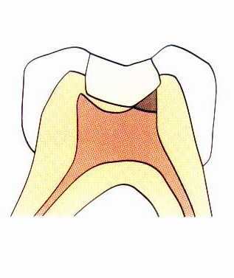
PARTIAL PULPOTOMY

Slide 72
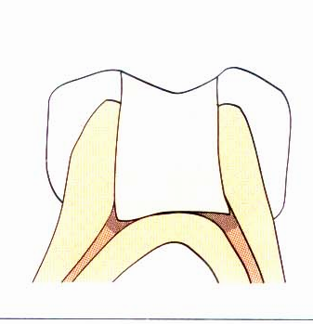
COMPLETE PULPOTOMY

Slide 73
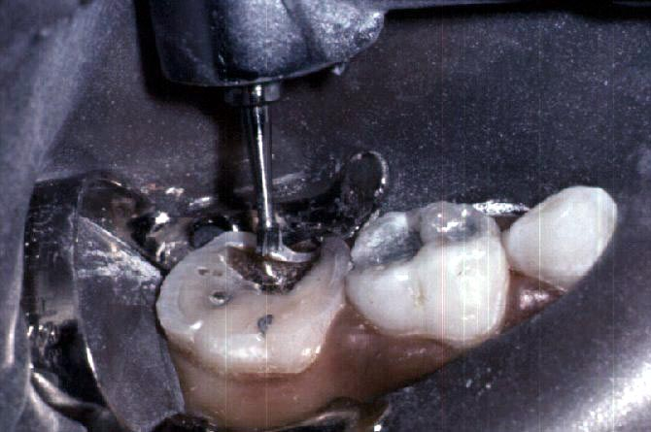
1- Completely
remove caries.

Slide 74
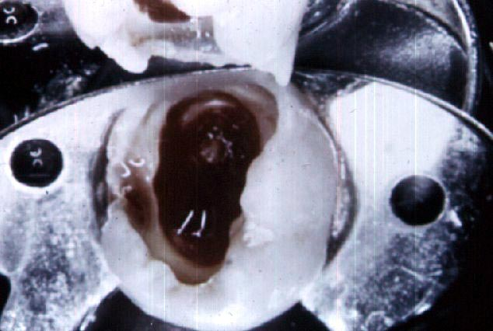
2- Open pulp chamber by completely removing the
roof with 330 high speed bur.

Slide 75
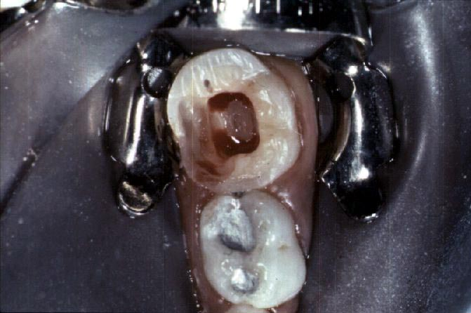
3- Remove pulp from pulp chamber with a sharp curette or a large round low-speed bur or a 330 high speed bur.

Slide 76
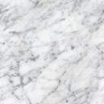
4- Stop bleeding by applying a moist cotton pellet in the pulp chamber for 3 minutes

Slide 77
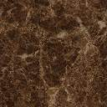
5- Place a cotton pellet with formocresol for 5 minutes in the pulp chamber.

Slide 78
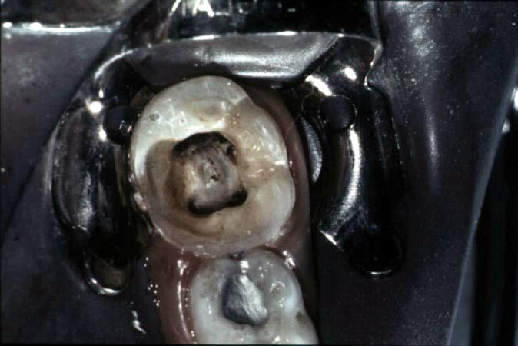
6- Remove cotton pellet and confirm pulp fixation, by the “black eye” appearance of the pulp stumps .
“Black eye”

Slide 79
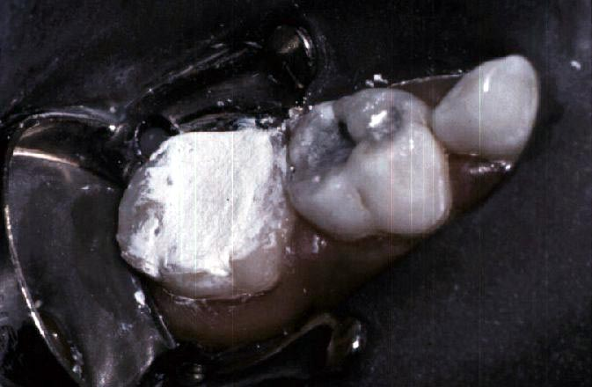
7- Fill the pulp chamber with ZOE-eugenol

Slide 80
Pulp amputation
Sharp spoon excavator
Large rotating round bur in slow speed.
Diamond drill – High speed
Electro surgery
Lasers
High speed drill with coolant – superior to spoon excavator or slow speed round bur - Least trauma to under lying pulp

Slide 81
Control of hemorrhage→ crucial for success
Control of hemorrhage :
Pressure application with moist cotton pellet
Haemostatic agent
Electro surgery
Laser energy
i. Blood less tissue incision
ii.Sterilization of pulp, promotes healing
iii. Scarring

Slide 82
Choice Of Pulpotomy Agent
Calcium hydroxide
Formocresol
Gluteraldehyde
Dentin adhesives
Light cure glass ionomers
Collagen, cyanoacrylates
B.M.P’s etc.

Slide 83
SUCCESS
The periodontium should remain healthy without pockets or sinus
The tooth should respond normally to the pulp vitality tests
Radiographically a calcific barrier should be seen
There should not be external or internal resorption
The root formation should have been completed with the apex closed
Clinically the tooth should be asymptomatic without tenderness and mobility

Slide 84
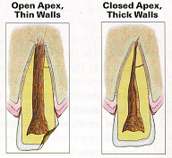
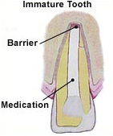
Apexogenesis
&
Apexification

Slide 85
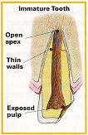
An immature pulp is one where apex is open.
No stop against which
gutta percha can be packed
Obturation becomes difficult
Apicectomy is not possible as it may fracture the root apex

Slide 86
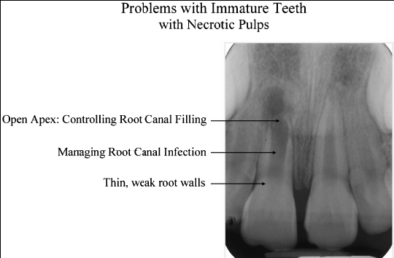

Slide 87
These problems can be managed by:
Using a disinfection protocol- minimizes root canal instrumentation.
Stimulating the formation of a hard tissue barrier/artificial apical barrier.
Reinforcing the weakened root against fracture.

Slide 88
Completion of root development and closure of the apex occurs upto 3 yrs after eruption of the tooth.
Depending upon the vitality of the affected pulp, two approaches are possible :
- Apexogenesis
- Apexification

Slide 89
Apexogenesis | Apexification
It is physiologic process of root development in vital infected tooth Normal or pulp tissue with minimal inflammation present | It is inducing the development of root apex in immature pulp less tooth by osteo cementum or bone like material Indicated in irreversible pulpal necrosis

Slide 90
Apexogenesis | Apexification
Normal root end development | Normal root development takes places rarely. Calcific barrier is formed clinically and radio graphically

Slide 91
Apexogenesis – “Vital pulp therapy”
It is physiologic process of root development.
“procedure performed to encourage continued physiological development and formation of root end”.
permits continued root growth and apical closure

Slide 92
Apexogenesis – “Vital pulp therapy”
Rationale
Sustaining viable Hertwig’s sheath→ continue root development → root length → favorable crown–root ratio.
Maintaining pulpal vitality →remaining odontoblasts→ lay down dentin→produce thicker root → decrease root fracture.

Slide 93
Apexogenesis – “Vital pulp therapy”
Goals
promoting root end closure, thus creating a natural apical constriction for root canal filling.
Generating a dentinal bridging - suggest that the pulp has maintained its vitality.
time range 1-2 yrs, depending on the degree of tooth development at the time of the procedure.

Slide 94
Apexogenesis – “Vital pulp therapy”
Indications:
Traumatized or pulpally involved vital permanent tooth with open apex.
No history of spontaneous pain.
No sensitivity on percussion.
No hemorrhage.

Slide 95
Apexogenesis – “Vital pulp therapy”
Contraindications:
When radicular pulp has undergone degenerative changes.
Purulent drainage
History of prolonged pain
Necrotic debris in canal
Periapical radiolucency

Slide 96
Apexogenesis – “Vital pulp therapy”
Materials used:
- Ca (OH)2
- Electrosurgery
- Laser
- Bone morphogenic protein
- MTA
- Enriched collagen
- Freeze-dried bone
- Osteogenic protein

Slide 97
Apexogenesis Calcium Hydroxide –mechanism of action
High ph- alkaline environment- stimulates bone and dentin formation.

Slide 98
Apexogenesis Calcium Hydroxide –mechanism of action
Undesirable effects-
Eventual complete calcification
(Calcific metamorphosis)
Persistence of induced inflammation-eventually causing internal resorption

Slide 99
Procedure
Application of rubber dam following local anaesthesia.
Remove all of carious tooth structure and open up the pulp chamber.
Remove coronal pulp tissue with sharp excavators, care is taken to prevent damage to radicular pulp.
Rinse all the residual debris and control hemorrhage by placement of a moist cotton pellet over the amputed pulp.

Slide 100
Procedure
Ca(OH)2 mixture is placed over the pulp stumps, followed by temporary restoration.
Follow-up radiographs are taken periodically to check the root development
Once root development is complete, the conventional root canal treatment is done.
Recall- 3 monthly interval-determine vitality and extent of pulp maturation.
If, evidence of necrotic changes- pulp extirpation and apexification therapy.

Slide 101
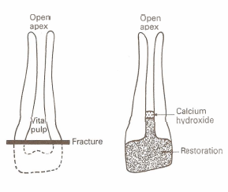
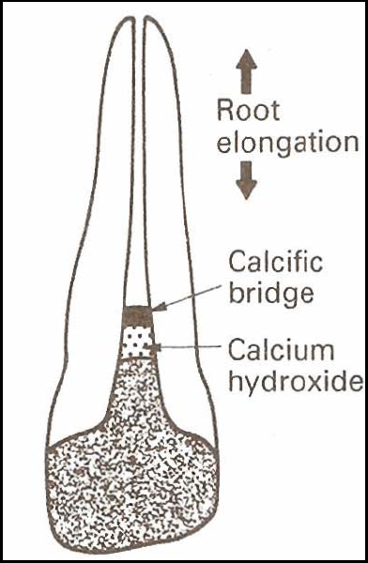
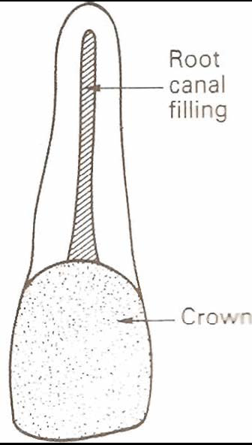
Apexogenesis

Slide 102
Apexogenesis

Slide 103
Apexification
Grossman-
“method to induce development
of the root apex of an immature, pulpless tooth by formation of osteocementum or other bone
like tissue”.

Slide 104
Apexification
Objective:
closure of open apical third of root canal
The formation of an apical calcific barrier
There should be no evidence of :
1. Abnormal canal calcification , internal or external resorption
2. Lateral root pathosis or
3. Breakdown of peri radicular supporting tissue
during or following treatment

Slide 105
Rationale:
Re activation of:
1. The residual undamaged pulp tissue
2. Odontoblastic layer associated with pulp tissue
3. Sheath of Hertwig

Slide 106
Material used:
ZnOE
Bioceramics
Biodentin
Resorbable tricalcium phosphate.
Collagen –calcium phosphate gel
Ca(OH)2
MTA

Slide 107
Apexification Technique:
Access is gained in the pulp chamber
Barbed broach used to remove debris and necrotic pulp tissue from the canal. Irrigation is performed with saline.
Length of the canal is established radio- graphically.
Care must be taken not to file against the incompletely formed thin and tapered internal walls of the root.

Slide 108
Apexification Technique:
Sonic and ultrasonic devices are extremely successful in debriding the canal.
Liberal irrigation with NaOCl solution helps to remove all organic and necrotic tissue.
After through Debridement, the canal is dried and just minimally medicated with CMCP

Slide 109
Apexification Technique:
If symptom persists or any signs of infection are present the canal is medicated
Canal is dried and filled with stiff mix of
Ca (OH) 2 + CMCP
The paste may be carried into the canal with
Amalgam carrier,
Lentulo spiral,
Disposable syringe,
Endodontic pressure syringe,
Pluggers

Slide 110
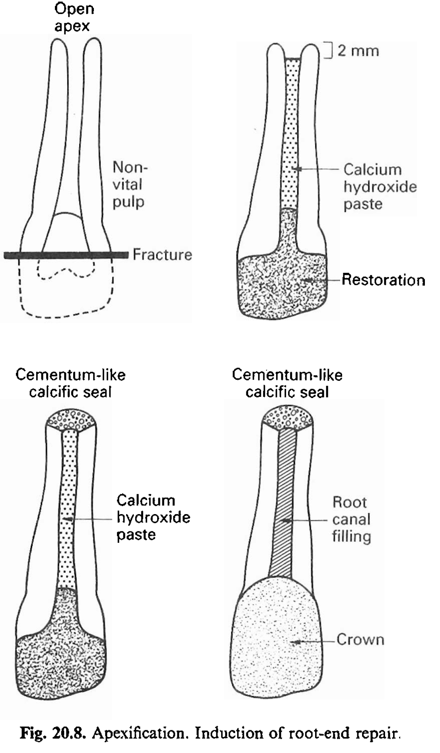
Apexification . Induction of root-end repair

Slide 111
Periodic recall:
Apical development is monitored by comparison of pre-operative and post-operative radiographs. We look for:
Formation of calcific bridge.
Continued apical development
Absence of internal resorption radiolucency

Slide 112
Periodic recall:
Time to achieve apexification is 6 to 24 months (average 1 year +/- 7 months).
Patient is recalled after every 3 months for radiographic evidence of calcification
The tooth is reentered and clinical verification is done by failure of small instrument to enter beyond apex after removal of Ca (OH)₂ pastes.

Slide 113
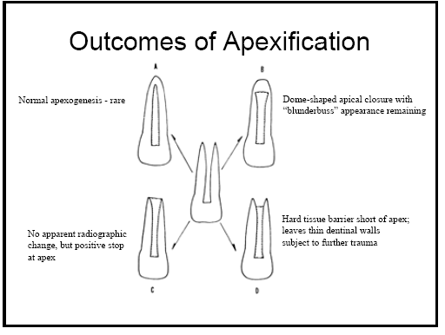
Frank (1966) – described 4 types of repair:

Slide 114
Apical Barrier Technique:
It is an alternative treatment that allows immediate obturation of the canal.
It has an advantage of:
Reduced cost
Less appointment
Better patient compliance
A sequel of root fracture because of thin
root can be avoided

Slide 115
Material used:
Ca{OH}2
MTA
Biodentin
Osteogenic protein – 1
Collagen phosphate gel
Freeze dried bone/dentin

Slide 116
One visit apexification – MTA
MTA – Mineral Trioxide Aggregate
First introduced in 1993 (approved by FDA – 1998)
Used for Apexification
MTA produced apical hard tissue formation with greater consistency

Slide 117
One visit apexification – MTA
Induction of apical healing – takes 3-4 months
- requires multiple appointment
- patient compliance
- failure of temporary seal; Resulting in – re-infection /prolongation or failure of treatment.
one visit apexification:
“as a non surgical condensation of a biocompatible material into the apical end of the root canal”.

Slide 118
One visit apexification – MTA
Rationale:
Establish an apical stop- enable immediate root canal filling.
No attempt at root end closure- an artificial stop is created.

Slide 119
One visit apexification – MTA
Limitations:
deficient sealing
possible periapical extrusion

Slide 120
Procedure :

Slide 122
Restoration after Apexification:
Thin dentinal walls – high incidence of root fractures.
Restoration must be designed to strengthen the root after obturation.
It can be done by light cure composite
Use of clear plastic post has been indicated

Slide 123
Restoration after Apexification:
In apical barrier technique using MTA, it is not necessary to place GP in canal it can be filled with composite resin
use of newer dentin bonding techniques –fracture strength close to intact teeth.

Slide 124






Slide 125




Slide 126
Regenerative Endodontics

Slide 127

REVASCULARIZATION/ REGENERATIVE ENDODONTICS

Slide 128
Minimal or no instrumentation
Irrigation with 2.5–5.25% NaOCl, 3% hydrogen peroxide
Metronidazole + minocycline + ciprofloxacin (equal parts) conc 20 mg/ml
avoid using calcium hydroxide as intra-canal medicament to prevent damage of the remaining pulp tissue, apical papilla and HERS

Slide 129

Clinical protocol:
Thorough irrigation
Antimicrobial paste slightly short of the remaining vital tissue with a lentulo spiral
Access cavity sealed with 2 mm-thick cavit as an inner layer and 2mm-thick durable cement such as glass ionomer as the outer layer.
2 weeks, patient re- evaluation.

Slide 130

Sympotomatic tooth → (several rounds of intra-canal irrigation & medication) → apexification
ASYMPTOMATIC:

Slide 131
re-access under microscope ; no observable virulent exudate
irrigate with NaOCl or chlorhexidine followed by sterile normal saline & dry
induce hemorrhage by an endodontic explorer penetrating slightly into the remaining pulp tissue or periapical tissue allowing blood clot to form in the canal & stopped 3mm below CEJ.
MTA was then placed over the blood clot & access cavity sealed with glass ionomer or resin-modified glass ionomer cement
period follow up.

Slide 132


Slide 133


Slide 134


Slide 135
Disinfection effective → pulp tissue healing & new dentin bridge formation.
Immature teeth with open apex has larger volume of pulp tissue with a rich blood supply → more potent in defending infection & healing.

Slide 136

References:
Textbook of Endodontics, Ingle 5th & 6th edi
Pathways of Pulp, Cohen 10th & 11th edi
Grossman 12th edi

Slide 137


